Slide 1
Biodiversity in National Parks
Interpretation of endangered animals in national parks

Slide 2
Introduction
This project will interpret data from the National Parks Service about endangered species in different parks. For that purpose it will analyze data on the conservation statuses of the species and investigate if there are any patterns or themes to the types of species that become endangered. It will be necessary to analyze, clean up, and plot data as well as pose questions and answer them.
Data sources:
Both Observations.csv and Species_info.csv was provided by Codecademy.com.
Note: The data for this project is inspired by real data, but is mostly fictional.

Slide 3
Goals for the project
Some questions to answer with the analysis are:
1. What is the distribution of conservation status for animals?
2. Are certain types of species more likely to be endangered?
3. Are the differences between species and their conservation status significant?
4. Which species were spotted the most at each park?

Slide 4
Conservation status
The total animal species given in the files provided were 5.824. And only 191 had a conservation status assigned. The reason why the rest of species don’t have this information is not clear, so this missing value is considered missing at random (there is no apparent reason why this information is missing).
There are a total of 4 categories in the conservation status:
Species in Concern
Endangered
Threatened
In Recovery
The distribution of these categories are in the chart of the next slide.

Slide 5
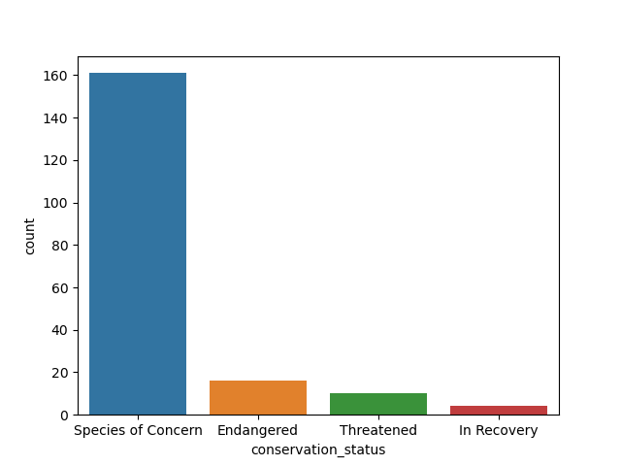

Slide 6
Endangered species:
Out of the total of the 191 labeled with a conservation status, 16 were endangered, such as the Gray wolf, the Indiana bat or the California Condor.
The categories of all 16 endangered species are:
Bird: 4
Vascular plant: 1
Mammal: 7
Amphibian: 1
Fisch: 3
The majority of the endangered species are Mammals, which can give the conservationists a clue where the problem is and what steps could the take.

Slide 7
Most observed species in National Parks
The four analyzed national parks are: Bryce National Park, Great Smoky Mountains National Park, Yellowstone National Park and Yosemite National Park.
The shown charts of the following slides show the 10 most observed species in each one of the parks.

Slide 8
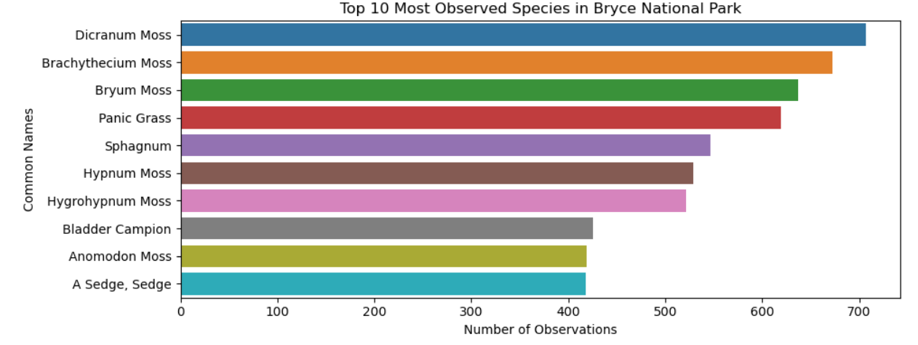
Species observed in Bryce National Park

Slide 9
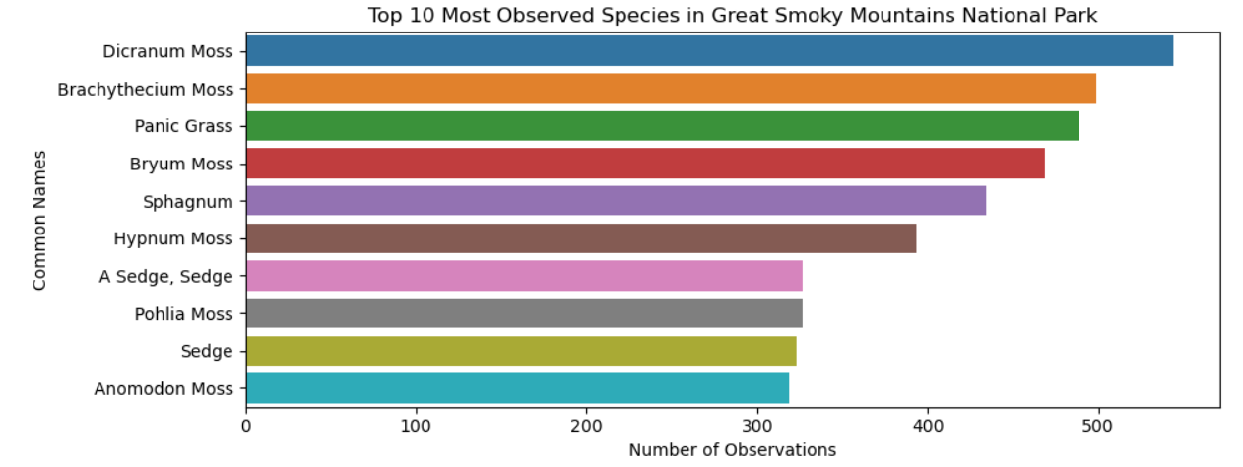
Species observed in Great Smoky Mountains National Park

Slide 10
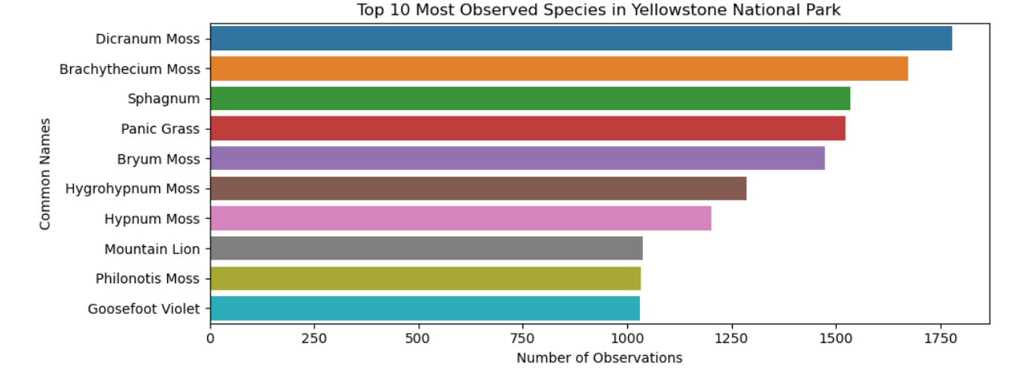
Species observed in Yellowstone National Park

Slide 11
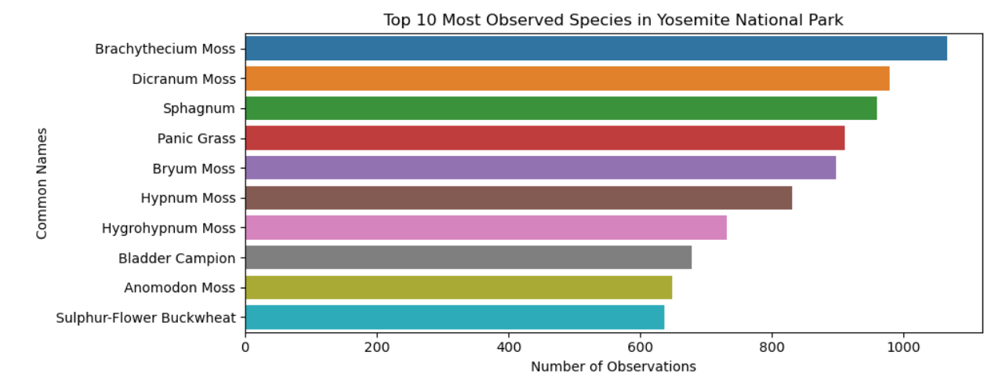
Species observed in Yosemite National Park

Slide 12
Conclusions
1. From the 5824 species in the parks, only 191 are classified by its conservation status. From the other species we don't have data to make any conclusions. We do not know the reason of the missing data. Could be because those species are not endangered at all or just because they haven't been classified for any random reason.
2. There are a total of 16 endangered species and a lot more (160 more or less) in concern. And only a few in recovery.
3. Most of the species endangered are Mammals.
4. The most observed species in all parks are "Brachythecium Moss" and the "Dicran Moss". But the most observed one was the Dicran Moss in the Yellowstone Park.

